Slide 1

Suicide Prevention and Mental Health Services
Stephanie Kastely MA, LPC
Suicide Prevention Coordinator
2017-2020 SAMHSA Garrett Lee Smith Award

Slide 2

Depression Warning Signs
Feelings of helplessness and hopelessness
Loss of interest in daily activities
Appetite or weight changes
Sleep changes
Anger or irritability
Loss of energy
Self-loathing
Reckless behavior
Concentration problems
Unexplained aches and pains

Slide 3
Anxiety Warning Signs
Persistent worrying or anxiety
Overthinking plans and solutions
Perceiving situations and events as threatening
Difficulty handling uncertainty
Indecisiveness and fear of making the wrong decision
Inability to set aside or let go of a worry
Inability to relax
Difficulty concentrating

Slide 4
Suicide Warning Signs
Talking about wanting to die or wanting to kill themselves
Talking about feeling empty, hopeless, or having no reason to live
Talking about being a burden to others
Using alcohol or drugs more often
Withdrawing from family and friends
Giving away important possessions

Slide 5
Suicide Prevention 101
Act
  “Are you talking/thinking about suicide?”
Safe
  Does the person have a plan? Reduce person’s access to highly lethal items or places
There
  Be there. Listening carefully and learning what person is thinking and feeling
Connect
  Help person connect with services and stay connected after care

Slide 6
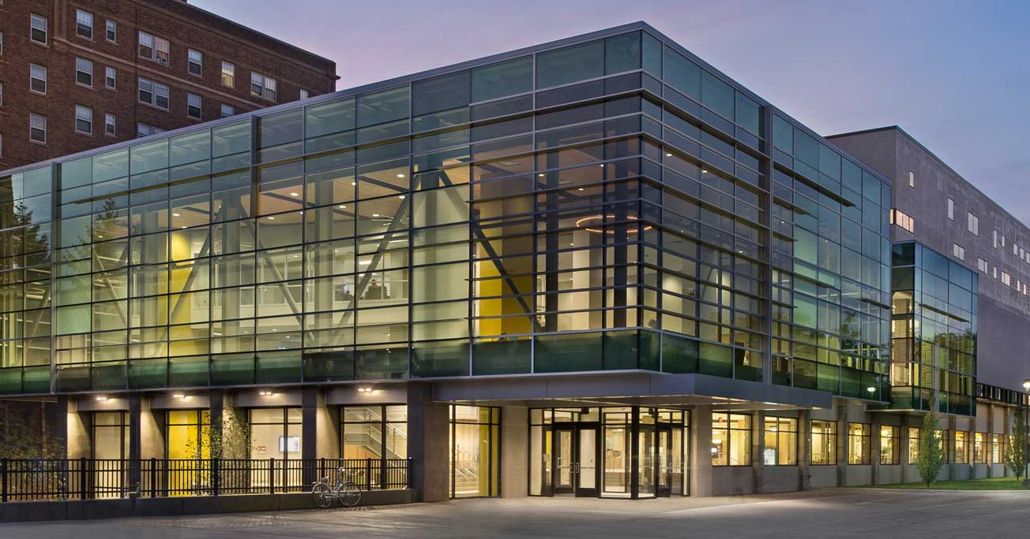
Mental Health Services at Wayne State University

Slide 7
What is Counseling?
Talk to someone who will listen without criticism and keep what you say confidential
Help you to look at situations from different perspectives
It is more than talking to a friend – the time is all yours

Slide 8
Mental Health Services
Counseling and Psychological Services (CAPS)
5th Floor Student Center Building
Counseling and Testing Center (COE)
3rd Floor Education Building
Psychology Clinic
60 Farnsworth Street, Rackham Building

Slide 9
CAPS Provides
Free, private, & confidential counseling to WSU students
Individual, group, and couples
Psychiatric services
Outreach
Presentations
Let’s Talk
Support groups
Prevention workshops
Referrals

Slide 10
Accessing Services
Office Hours
8:30AM – 5PM
Triage Hours
No appointment needed!
M-F, 9AM-4PM
45-60 minutes
Computer assessment & meet with a counselor

Slide 11
Need Additional Support?
Visit our website at www.caps.wayne.edu
Stop by 552 Student Center Building
Call CAPS-(313) 577- 3398
File a CARE Report
https://doso.wayne.edu/conduct/student-support-intervention

Slide 12
Other Mental Health Services
Protocall Afterhours
(After 5pm and weekends)
313-577-9982
Counseling and Testing Center
(313) 577-1681
Office Mon-Thurs 2pm-7pm
Sessions Mon-Thurs 4pm-7pm
WSU Psychology Clinic
(313) 577-2840
Mon. & Wed. 9-7 Tue. & Thu. 9-8 Friday 9-5

Slide 13
Other Resource Information
The National Suicide Prevention Lifeline
1-800-273-TALK (8255)
The Crisis Text Line
741741
Detroit Wayne County Mental Health Authority (DWMHA)
800-241-4949 or 313-833-2500
www.suicideprevention.wayne.edu

