Slide 1
Course vs. Program
Learning Outcomes:
Analogies and Examples
Dr. Cathy Barrette
WSU Director of Assessment
c.barrette@wayne.edu
assessment.wayne.edu

Slide 2
What Are Learning Outcomes?
Specific, measurable statements of what graduating/exiting students should know, be able to do, believe, or value after completing the program
  Observable behaviors whenever possible
Focused on the results of student learning, not on the learning process or on teaching
Derived from the program’s mission statement

Slide 3
Levels of Outcomes
Outcomes can be identified at many organizational levels:
  Institutional
  College/School/Division
  Department
  Program
  Course
  Class session/Lesson
Program outcomes are the focus for program assessment

Slide 4


An Analogy: Salads and Outcomes
These two pictures have similar ingredients. Why is only one a salad?
Notes:
http://www.google.com/imgres?imgurl=http://www.cicispizza.com/images/mobile-template/salad.jpg%253Fsfvrsn%253D0&imgrefurl=http://www.cicispizza.com/menu-items/soup-salad/garden-salad&h=2386&w=3225&tbnid=MZGRhd1bvPbAuM:&zoom=1&docid=Apv5TzmuH8rcsM&ei=mrkBVbaJM5HbsATc7oKYDg&tbm=isch&ved=0CBwQMygAMAA

Slide 5
The difference in ingredients’ degree of preparation and integration makes only one image a salad.
The ingredients contribute to the salad, but a salad is more than the sum of its parts.
Notes:
http://www.google.com/imgres?imgurl=http://www.cicispizza.com/images/mobile-template/salad.jpg%253Fsfvrsn%253D0&imgrefurl=http://www.cicispizza.com/menu-items/soup-salad/garden-salad&h=2386&w=3225&tbnid=MZGRhd1bvPbAuM:&zoom=1&docid=Apv5TzmuH8rcsM&ei=mrkBVbaJM5HbsATc7oKYDg&tbm=isch&ved=0CBwQMygAMAA

Slide 6
From Salads to Outcomes
Course outcomes identify “the ingredients” that make up the program
  Incremental knowledge and skills that students develop bit by bit throughout the program
  Aligned with – but typically narrower than – program outcomes
Program outcomes characterize “the salad” – what individual ingredients make once they are prepared and integrated
  Students’ cumulative learning across courses at the end of the program

Slide 7
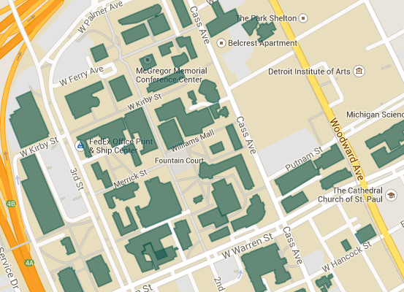
Another Analogy: Map Scale
Zoom out for program outcomes to get the big picture, i.e., a view of how all of the parts fit together.

Slide 8
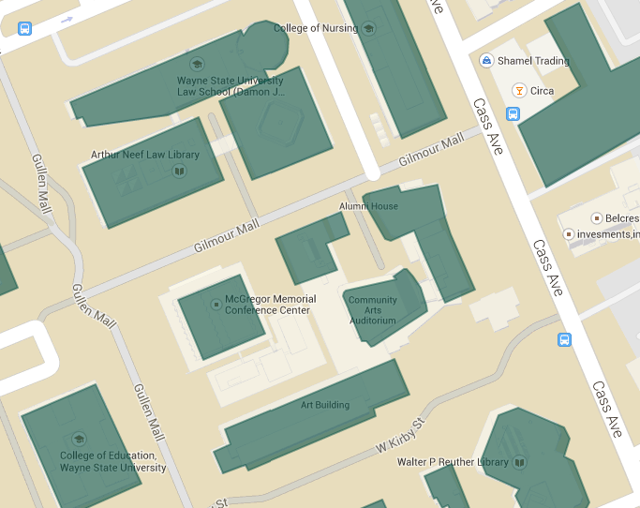
Zoom in for course outcomes to get a view of the individual parts that make up the whole.

Slide 9
Academic Program Example
Program Mission: Professional development for foreign language teachers
Program Outcome 1: Students summarize second language acquisition theory and research
Course Outcome: Students critically evaluate research on second language acquisition
Program Outcome 2: Students evaluate pedagogical materials
Course Outcome: Students critically evaluate various pedagogical approaches to the teaching of speaking and writing within students’ own instructional contexts
Course Outcome: Students apply (an)understanding [of research on valid assessment] to the critique of assessment instruments appropriate and useful to individual teaching circumstances
Notes:
Course outcomes are from three MA in Language Learning courses: Theories of Second Language Acquisition, Teaching Foreign Languages: Productive Skills, and Foreign Language Testing

Slide 10
More Information
Would you like more information about program assessment? Visit assessment.wayne.edu for:
  Video tutorials
  PowerPoint presentations
  Templates
  Supporting documentation
  Examples
  WSU progress reports
  And more!

