Slide 1
Program Assessment:
Writing a Mission Statement
Specify intended outcomes
Measure whether students are meeting those outcomes
Improve your program based on results
Identify program goals
The Program Assessment Process
Cathy Barrette, Director of Assessment
Wayne State University

Slide 2
Presentation Overview
To help you write a mission statement, this presentation provides:
an explanation of what a mission statement is
examples from Wayne State’s academic and student services programs
guiding questions to help your program develop a mission statement
pitfalls to avoid when developing a mission statement

Slide 3
Mission Statement
A brief description of the program’s:
  Purpose - Why the program exists, including its broad goals and unique or signature features
  Offerings– What kinds of opportunities students or clients will have for achieving the program’s goals (e.g., coursework, internships, service learning)
  Target audience/Stakeholders – Who benefits from the program
Aligned with university and division missions
Realistic and achievable
Notes:
Color coding matches sections in examples on subsequent slides
Stakeholders might be students, the community, other units at the university; each program defines their stakeholders beyond students.

Slide 4
Usefulness
A mission statement is like a guiding principle: explicitly articulating it helps guide programmatic decisions.
For example, you can use your mission statement to
  Prioritize your use of and requests for funding, faculty lines, course offerings, extra curricular programs
  Decide which courses should be required or elective
  Identify new areas of expansion

Slide 5
Example: BFA in Dance
The mission of the BFA Program in the Maggie Allesee Department of Theatre and Dance is to [prepare] [students] [for professional careers in dance.] The Program provides preparation for pursuits in [performance, choreography and production through practical study of dance techniques, theoretical and historical studies, exploration of current trends in the art and frequent engagement with professional dance artists.] The program provides [abundant performance experiences] for [BFA students as it serves the urban metropolitan community] in which Wayne State University resides.

Slide 6
Example: MS in Taxation
Our mission is to [prepare] [students] [for careers requiring a high degree of specialized tax knowledge] [in public accounting, private industry, and government by emphasizing a thorough grounding in the principles of tax research, corporate taxation, and flow-through entities as well as ethics and professional communications.]

Slide 7
Example: PhD in Biochemistry and Molecular Biology
The mission of the PhD program in Biochemistry and Molecular Biology is to train [graduate students] through [advanced course work, critical analysis of the primary literature and apprenticeship to a practicing scientist] to [develop an understanding of the theoretical and practical aspects of biomedical research. Special emphasis is placed upon critical thinking and written and oral communication skills to further prepare graduating students to pursue a variety of different career options] where a thorough understanding of research is essential.

Slide 8
Example: UG Certificate in Nanoengineering
The nanoengineering certificate program offers students [multidisciplinary, in-depth training in the emerging technological area of nanotechnology] by offering new [lecture, laboratory, and seminar courses that cross traditional departmental and disciplinary boundaries. Students gain hands-on experience with advanced instrumentation and cleanroom operation. Students conduct research with faculty and industrial partners.] The certificate program [fulfills the educational needs of working engineers and technical professionals], targeting especially those in the Metro Detroit area and Windsor, Canada.

Slide 9
Mission Statement:
Guiding Questions
To help you get started on your mission statement, you might discuss the following questions with your colleagues:
What need(s) does the program fulfill?
What kinds of learning opportunities does the program provide?
What does this program uniquely offer that differentiates it from other programs?
Notes:
Uniqueness might be in terms of a particular focus/priorities, breadth/depth, expertise, career path, teaching methodology, professional opportunities
University UG or Graduate Bulletin descriptions might be helpful for academic programs as a starting point for discussion. Does the description address the points above? Does it accurately reflect what we want our program to do?
Previous program review or accreditation documentation might also be useful.

Slide 10
Mission Statement:
Pitfalls to Avoid
Wording that is:
Too general, applicable to any program
Descriptive of a department or unit rather than one specific program
Focused on teaching or research rather than student learning
Written for a specialist/expert audience rather than a general audience

Slide 11
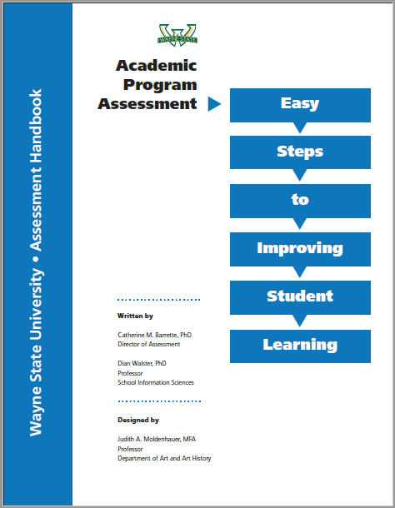
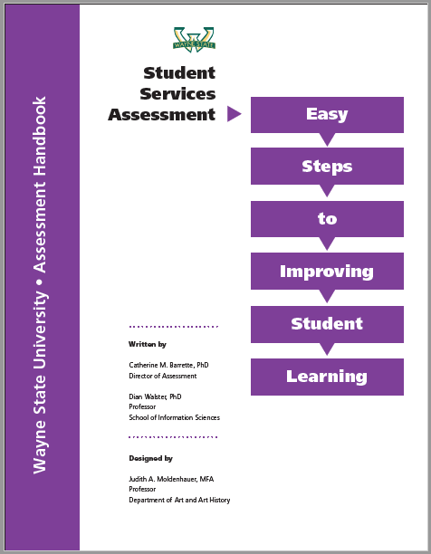
Want More Information?
Additional presentations and the assessment handbooks explain how to:
  Write mission statements
  Write learning outcomes and curriculum maps
  Choose assessments
  Understand and use results
  Use Planning to record your work
Each part has examples and pitfalls to avoid as well!

Slide 12
Local Resources for Program Assessment
Cathy Barrette, WSU Director of Assessment
  c.barrette@wayne.edu
  (313)577-1615
WSU Assessment website https://wayne.edu/assessment/
OTL staff, workshops and website: http://otl.wayne.edu/

